Slide 1
Data exploration in SQL 16/06/2023
120 years of Olympic history: athletes and results

Slide 2
In this project
  1. Dataset
  2. Load the data into PostgreSQL
  3. Data exploration
  4. Comments

Slide 3
Dataset
120 years of Olympic history: athletes and results
This dataset contains two tables : one about the Olympic athletes and their performances in various sports events, and the other about the regions.
Link of the dataset : https://www.kaggle.com/datasets/heesoo37/120-years-of-olympic-history-athletes-and-results?select=noc_regions.csv

Slide 4
Dataset – athlete_events table
Name of the column | details
ID | An identifier for each athlete.
Name | The name of the athlete.
Sex | The gender of the athlete (M for male, F for female).
Age | The age of the athlete at the time of the Olympic Games.
Height | The height of the athlete in centimeters.
Weight | The weight of the athlete in kilograms.
Team | The team or country the athlete represents.
NOC | The National Olympic Committee code for the country.
Games | Year and season of the Olympic game.
Year | The year of the Olympic Games.
Season | The season of the Olympic Games (Summer or Winter).
City | The host city.
Sport | The sport in which the athlete participated.
Event | The specific event within the sport.
Medal | The medal won by the athlete in the event (Gold, Silver, Bronze, or NA if no medal was won).

Slide 5
Dataset – noc_regions table
This table is used to retrieve the country in which the NOC belongs to.
Name of the column | details
NOC | National Olympic Committee 3 letter code
Regions | Country name
Notes | Notes

Slide 6
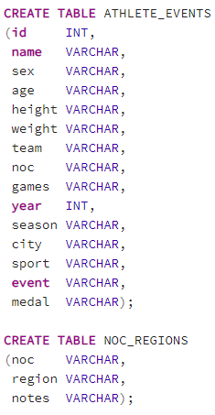
Load the data into Postgresql
I have created two tables based on the athlete_events.csv and noc_regions.csv
The columns ‘id’ and ‘year’ have only numeric values.
The other columns consist of only letters or a combination of letters, numbers, and even special symbols for the ‘event’ column. That's why I assigned them the VARCHAR data type.

Slide 7

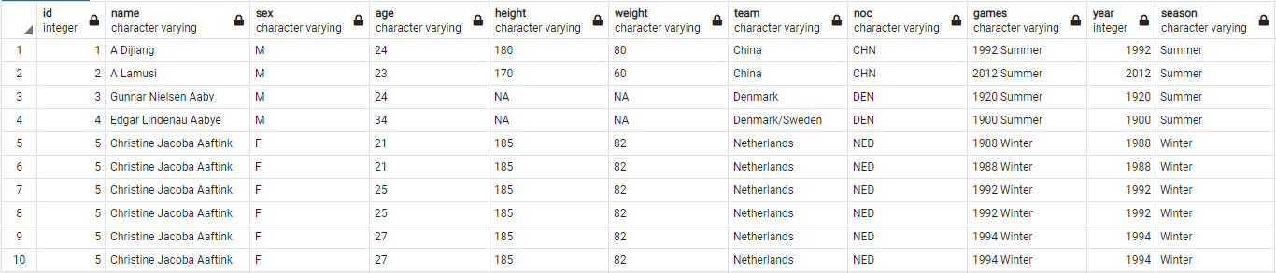
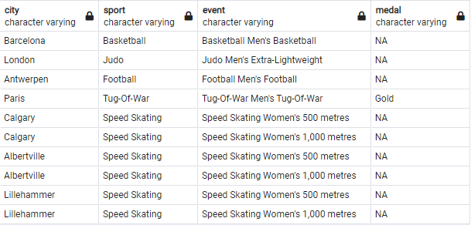
Data exploration
Let’s first have a view of the data from the athlete_events table :

Slide 8

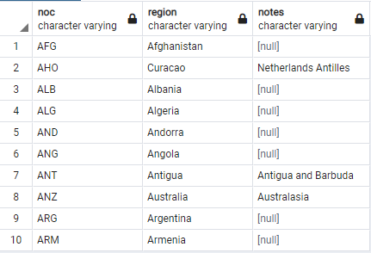
Data exploration
noc_regions table :

Slide 9
Data exploration
There are numerous of insights we can get from this dataset. However, I’m going to focus on answering some questions.
I will answer questions about :
Gender distributions
The age of participants
Medals distribution
Some results will be compared with french athletes.

Slide 10
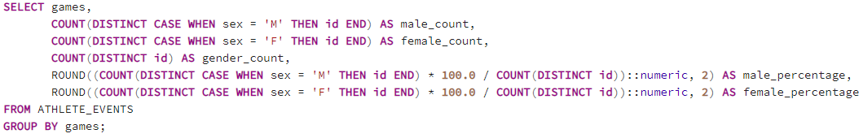
Data exploration – gender distribution
What is the number and percentage of female and male participants in each Olympic game ?
Some participants participated in more than one sport, but they are counted as one person in this query.
The reason I used ::numeric in the query is to ensure that the division operation produces a result with decimal places. By default, when performing division in PostgreSQL, if both the dividend and divisor are integers, the result will be an integer, and any decimal places will be truncated.

Slide 11
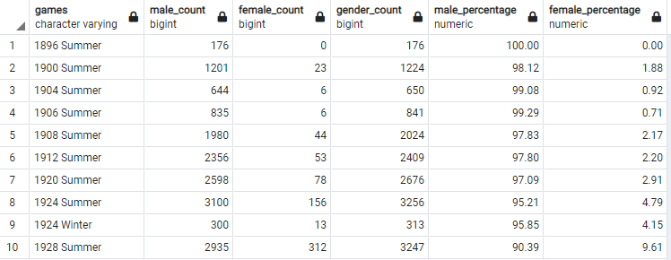
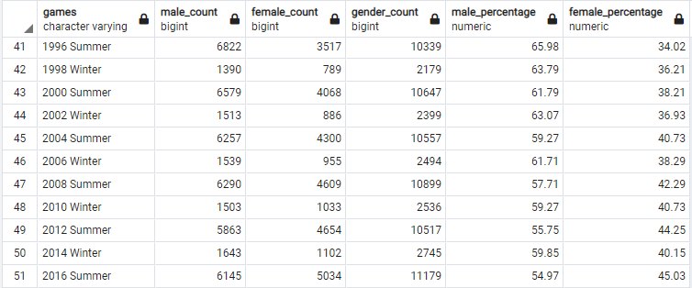
Data exploration – gender distribution
We observe a consistent upward trend in the participation of women in the Olympic Games, with the percentage continually rising over the years.

Slide 12
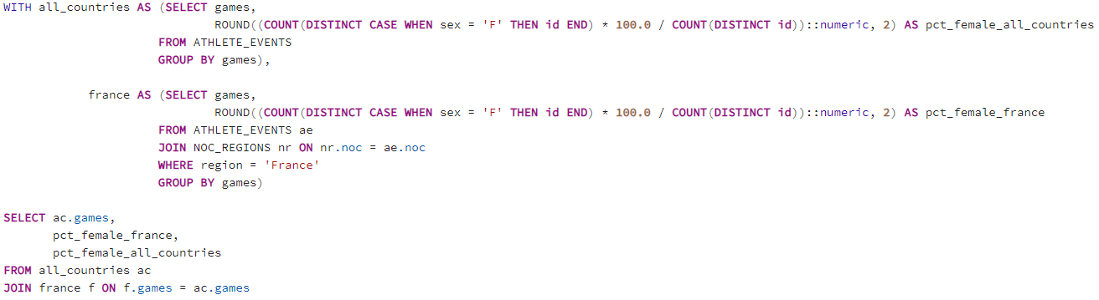
Data exploration – gender distribution
What about France ?

Slide 13
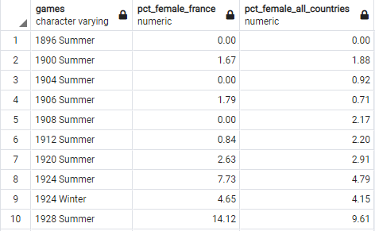
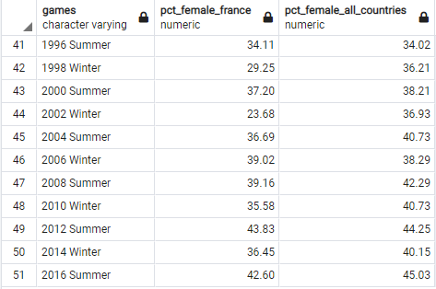
Data exploration – gender distribution
What about France ?
It appears that the proportion of female athletes in France is most of the time lower compared to the global proportion for female participation.

Slide 14
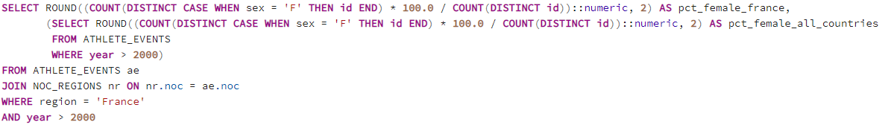

Data exploration – gender distribution
Let's examine the percentage of female athletes in the more recent Olympic Games, specifically starting from the 2000’s Games.
On average, France exhibits a lower percentage of female participants compared to the overall percentage of female participants from all countries combined.

Slide 15
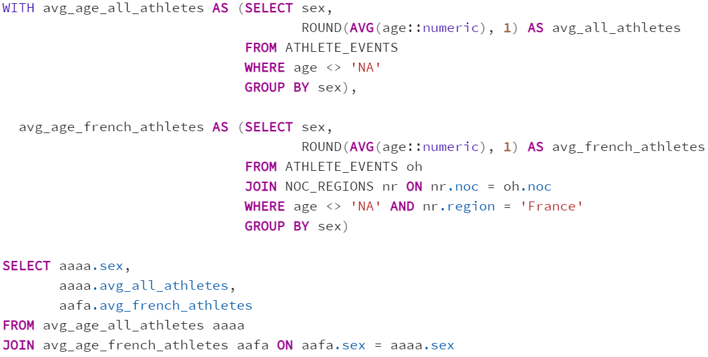
Data exploration – Age analysis
What is the average age of male and female participants ? Comparison between French athletes and the global average.

Slide 16

Data exploration – Age analysis
What is the average age of male and female participants ? Comparison between French athletes and the global average.
French athletes are, on average, older than the total average all countries combined.

Slide 17
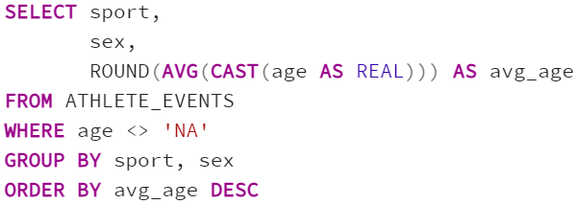
Data exploration – Age analysis
What is the average participant age in each sport ?

Slide 18
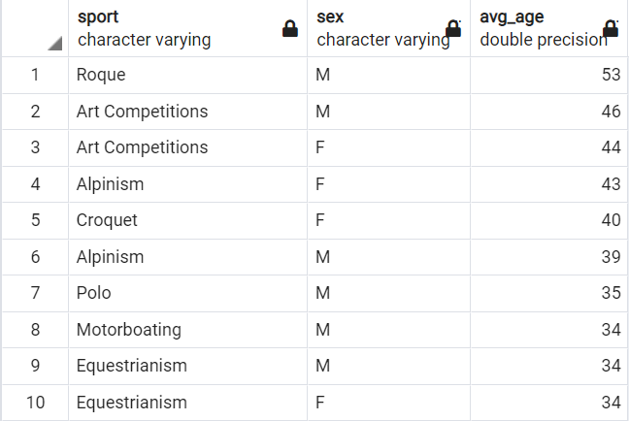
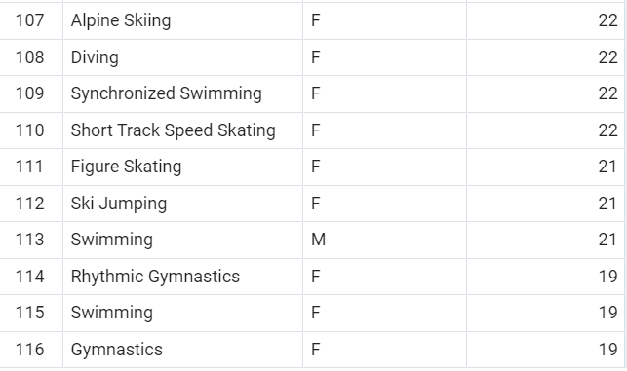
Data exploration – Age analysis
What is the average participant age in each sport ?
Some sports are not played anymore. Let's zoom in recent olympic games.

Slide 19
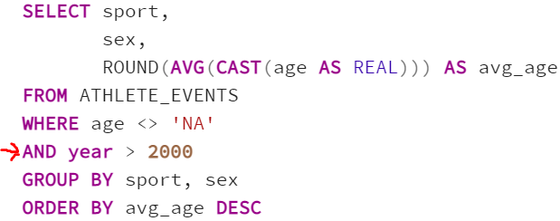
Data exploration – Age analysis
What is the average participant age in each sport ?

Slide 20
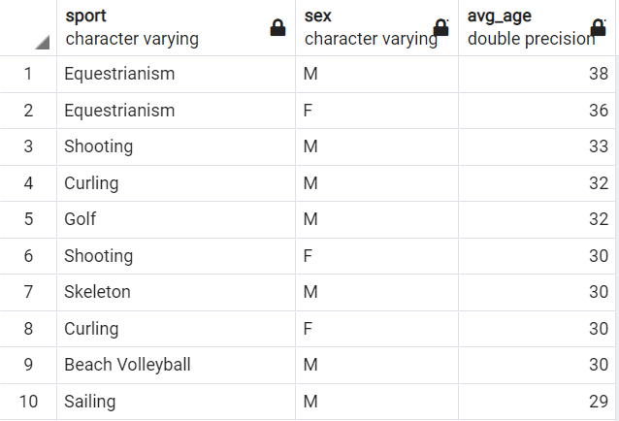
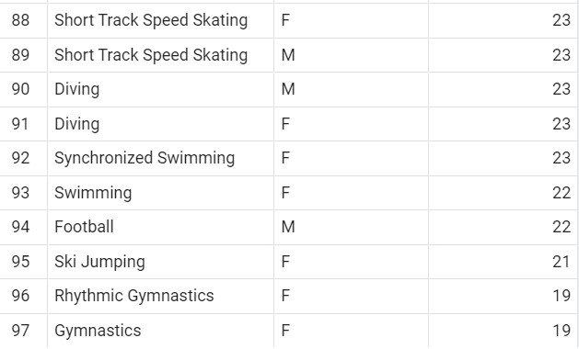
Data exploration – Age analysis
What is the average participant age in each sport ?
Interesting facts : Equestrianism is the sport where participants are older on average (38 for male and 36 for women).
Gymnastic is the sport where women tend to be younger (19 years old on average).
Football is the sport where Male are younger (22 years old on average)

Slide 21
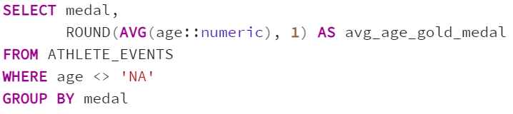
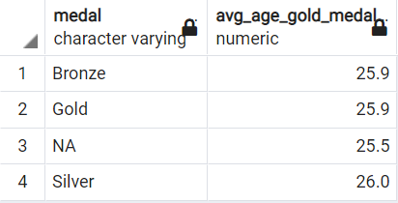
Data exploration – Age analysis
What is the average age of medal winners ?

Slide 22
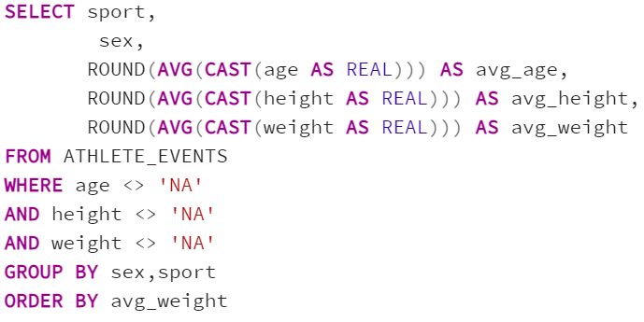
Data exploration – Individual characteristics
What are the individual average characteristics by sport and gender ?

Slide 23
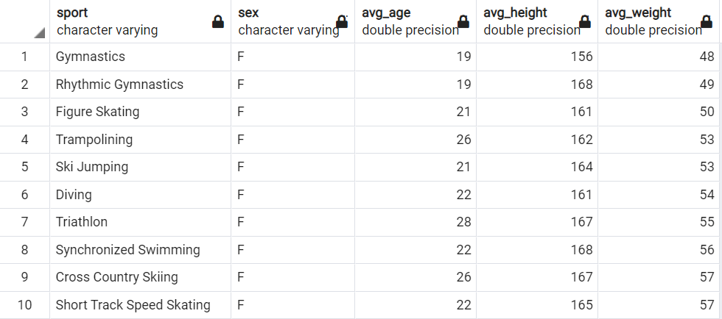
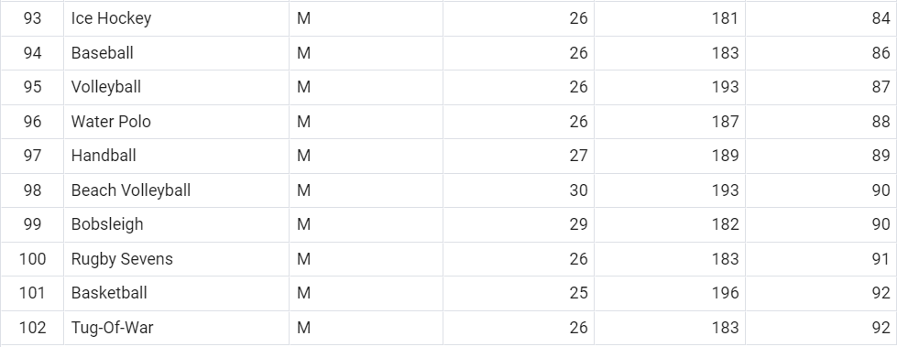
Data exploration – Individual characteristics
What are the individual average characteristics by sport and gender ?
Interesting fact :
The sport where the athletes are the smallest is Gymnastic with an average height of 156cm for women and 168cm for men; followed by weightlifting.

Slide 24
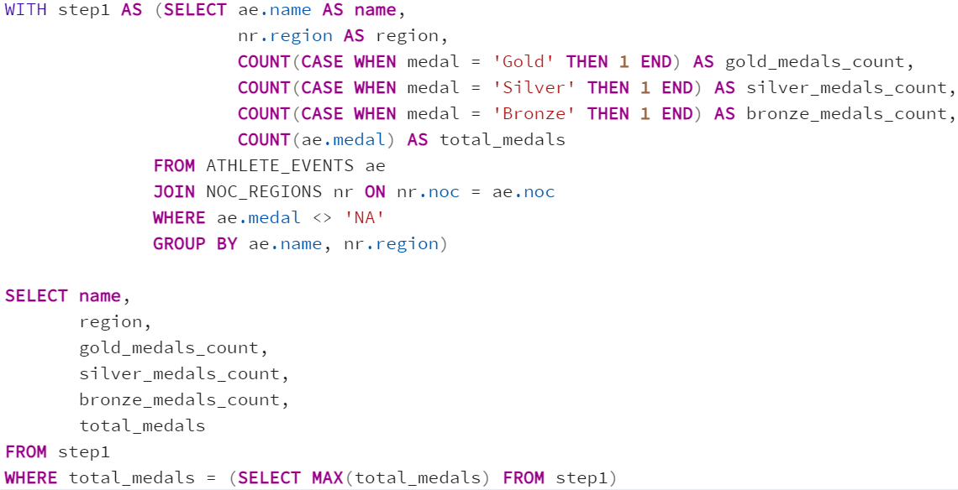
Data exploration – Medal analysis
Who has won the most medals ?

Slide 25
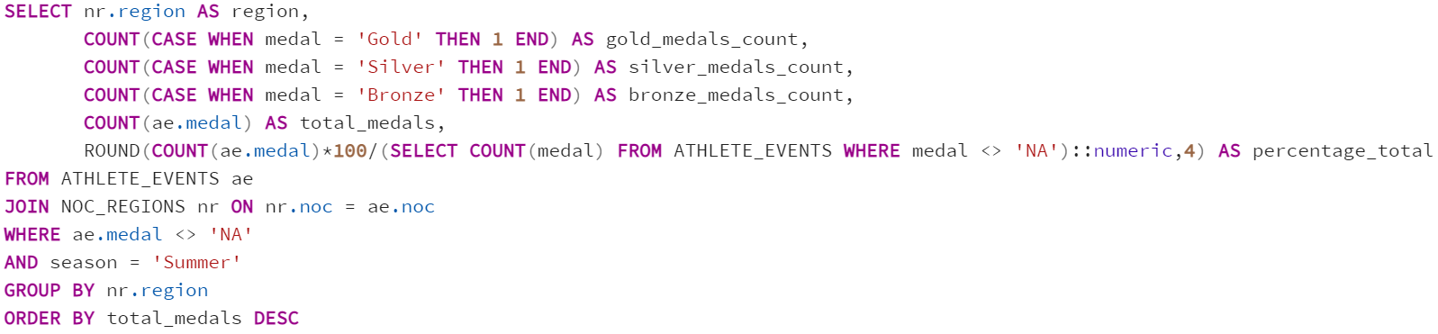
Data exploration – Medal analysis
How many medals each country won in summer Olympics ?

Slide 26
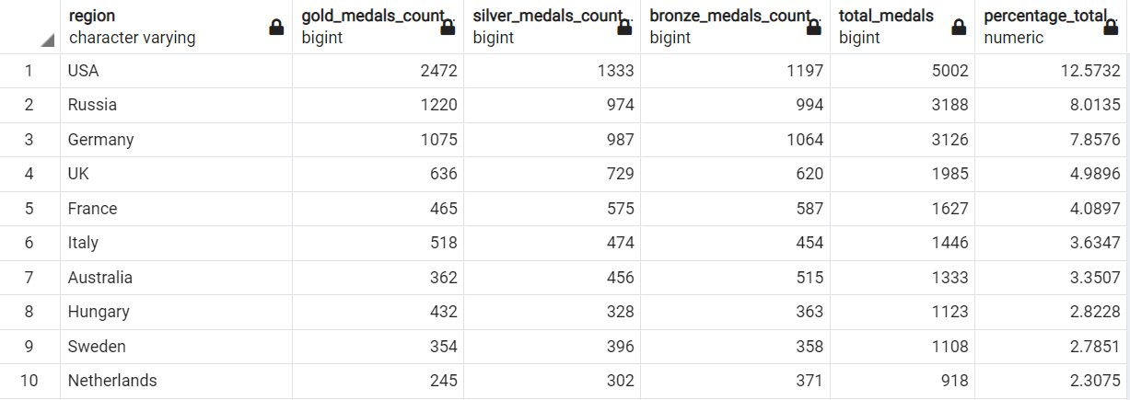
Data exploration – Medal analysis
How many medals each country won in summer Olympics ?
Interesting facts :
USA is the country who won the most medals by far.
50% of the medals were won by 9 countries

Slide 27
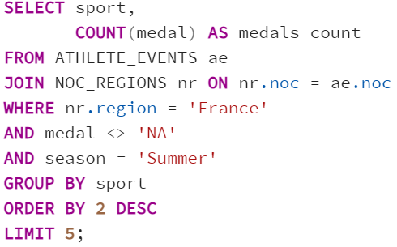
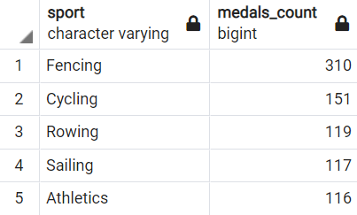
Data exploration – Medal analysis
What are the top 5 sports in which France has won the most medals in summer Olympics ?

Slide 28
Comments
Once again, I know that further analysis could have been done. The aim of this project was for me to work with a real dataset and to showcase my skills in sql.
I hope you find my work interesting, and I am completely open to any feedback.
Thank you !
Arnaud Plonévez

